Slide 1

MRF for Image segmentation & Denoising
Mathematics for intelligent systems
TEAM 13
CB.EN.U4AIE19016 – ASSWIN C R
CB.EN.U4AIE19024 – DHARSHAN KUMAR K S
CB.EN.U4AIE19028 – AVINASH DORA
CB.EN.U4AIE19060 – SIVA PRAKASH R

Slide 2
Introduction
Markov Random Fields

Slide 3
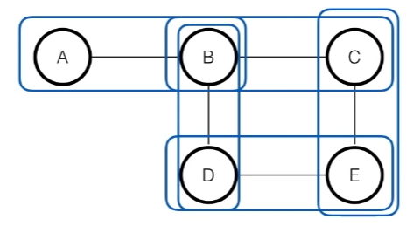
Markov Random Field
A Markov Random Field (MRF) is a probability distribution p over variables x1,…,xn defined by an undirected graph G in which nodes correspond to variables xi.
A potential is a non-negative function of the variable x. A joint potential is a non negative function of the set of variables.
For a set of variables a Markov Random Field is defined as a product of potentials over the (maximal) cliques of the Undirected graph G.

Slide 4
-Cliques are subset of Variables.( for eg the 1st clique can contain x1 ,2nd as x1, x2 etc) depending upon the graphs.
-1/Z is the normalizer, known as the partition function. To make the LHS , P(X) a proper probability distribution.
Special cases for Clique size two : Pair-wise Markov Random Field
If all potentials are strictly positive: Gibbs Distribution

Slide 5
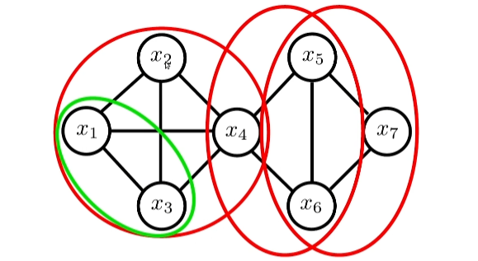
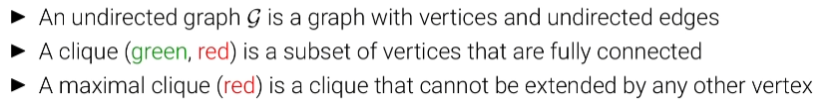
Undirected Graph:
- Vertices represents random variable.
-edges represents the dependencies/relation between the random variables.

Slide 6
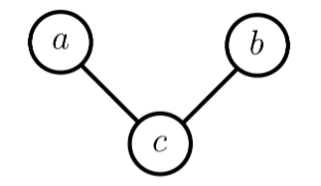

Example
- has 3 random variables
- here , 2 clique are maximal cliques [ (a,c) and (a,b) ]
- Z , partition function which sums to 1., in order to do , we take the above expression and sum it all over the combinations of a,b,c .

Slide 7
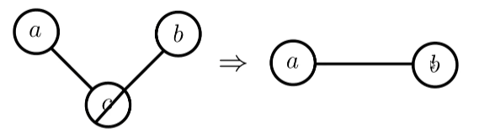

Properties of MRF:
Marginalizing:
Marginalizing over c makes a and b dependent ( earlier independent) and becomes directly connected.
Probabilty of a,b joint distribution is not equal to p(a).p(b)

Slide 8
Proof ()

Slide 9


Slide 10
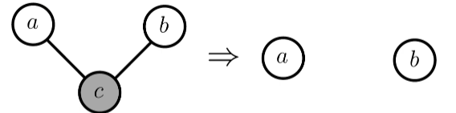

Property 2 : Conditioning
- Conditioning on c makes a and b independent
- above expression can be proved by following the same approach as Property 1.

Slide 11
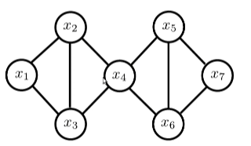
Global Markov Property
S
Separation:
A subset S separates A from B if every path from a member A to any member of B passes through S.
Global Markov Property
For disjoint sets of variables (A,B,S) where S separates A from B, we have A B|S
which means, if we conditioning x4, then x2 becomes conditionally independent of x5 or x1|| x5 or x3|| x5 etc..
Collection of random variable, x1,x2,x3 || x5,x6,x7
B
A

Slide 12
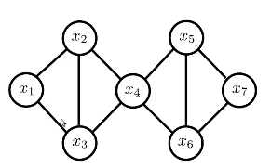
Local Markov Property.
When Conditioned on its neighbours, x becomes independent of the remaining variables of the graph.
for eg x1 conditioned on other random variables x2,x3,x4,x5,x6,x7 is equal to x1 conditioned on x2 and x3, because x2 and x3 shield x1 from remaining variables.( separation property).
-Set of neighbouring nodes ne(x) is called as Markov Blanket.

Slide 13
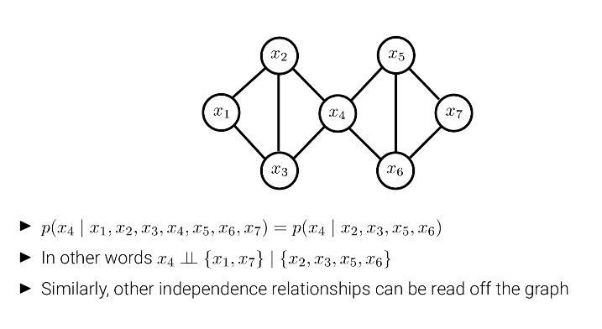
Example

Slide 14
MRF for Image Segmentation

Slide 15

Image Segmentation
Image segmentation is the process of partitioning a digital image into multiple segments (sets of pixels, also known as super pixels). The goal of segmentations to simplify and/or change the representation of an image into something that is more meaningful and easier to analyze. Typically, image segmentation is used to locate objects and boundaries (lines, curves, etc.) in images.
Image segmentation is the process of assigning a label to every pixel in an image such that pixels with the same label share certain characteristics.

Slide 16
Probabilistic graphical models are widely used in various low-level to mid level tasks in image processing and computer vision.
MRF characterize the each pixel and the relationship among neighbors using unary function, and pairwise potential functions, respectively.
Therefore, the tasks are transformed into an optimization problem, where an objective function representing the total energy is to be minimized.

Slide 17
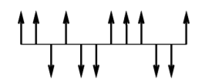
Ising Model
Consider a sequence, 0,1,2,...,n on the line.
At each point, there is a small spin which is either up or down at any given moment ( from the above figure).
. Now, we define a probability measure on the set Ω of all possible configurations ω = (ω0,ω1,...,ωn). In this context, each spin is a function given by equation

Slide 18
This above term represents the energy caused by the spin-interactions.
In the first sum, Ising made a simplifying assumption that only interactions of points with one unit apart need to be taken into account.
The constant J is a property of the material. If J > 0, the interactions tend to keep neighbouring spins in the same directions (attractive case). If J < 0, neighbouring spins with opposite orientation are favoured (repulsive case).
The second term represents the influence of an external magnetic field of intensity H and m > 0 is a property of the material.
Finally these spins are arranged on a lattice, which are represented by two coordinates and a point having 4 neighbours.

Slide 19
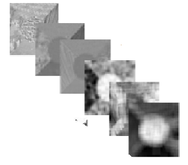
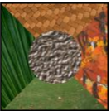
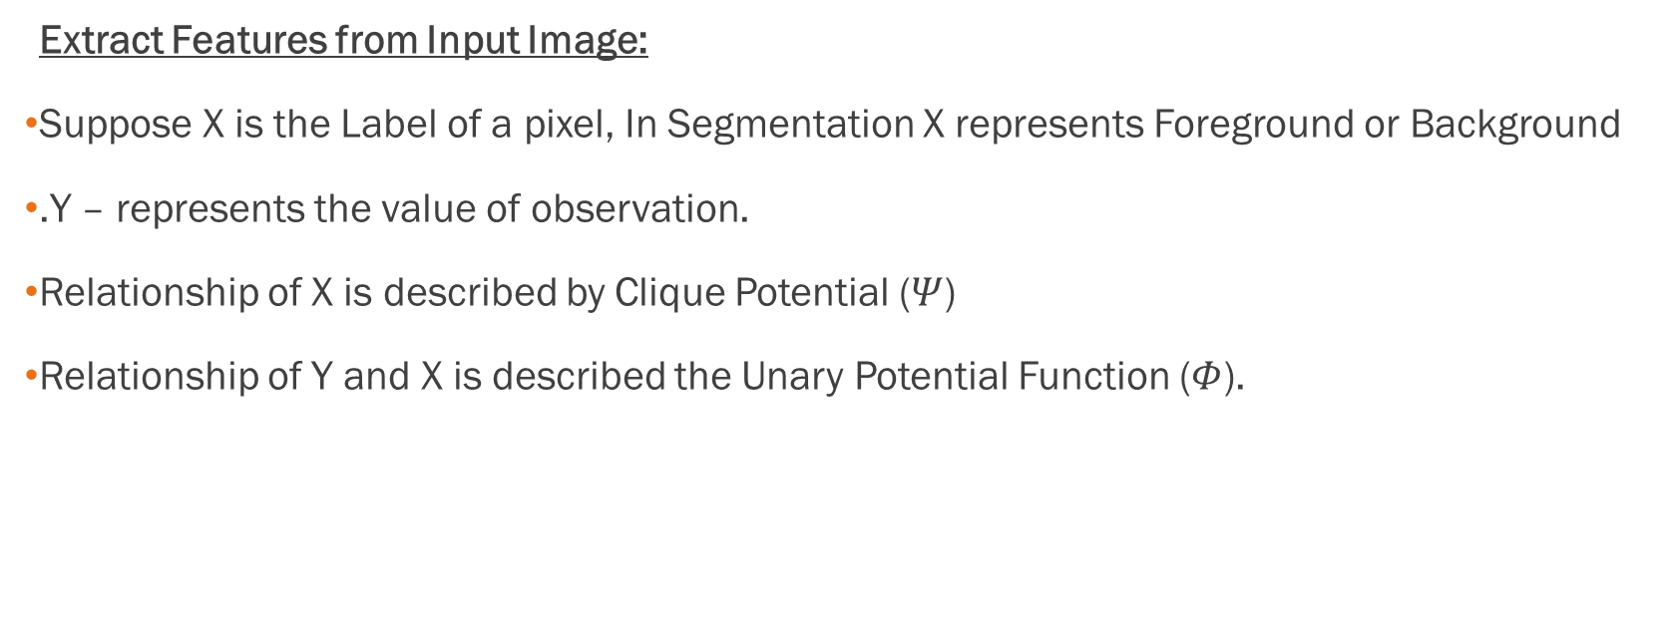
Pair-wise MRF
Extract Features from Input Image:
Suppose X is the Label of a pixel, In Segmentation X represents Foreground or Background
.Y – represents the value of observation.
Relationship of X is described by Clique Potential ($Ψ$)
Relationship of Y and X is described the Unary Potential Function ($Φ$).

Slide 20
Pair-wise MRF
Pairwise MRF only considers pairwise neighborhood, which means the local interactions of the nodes in MRF is defined by pairwise potential Ψ(xi, xj), where xi and xj are neighboring nodes, where xi and xj areneighboring nodes.
The joint distribution of X and Y is given by:
$$P\left(X , Y\right)=\frac{1}{Z}\underset{i,j}{Π}Ψ\left(x_{i} , x_{j}\right)\underset{i}{Π}Φ\left(x_{i} , y_{i}\right)$$

Slide 21
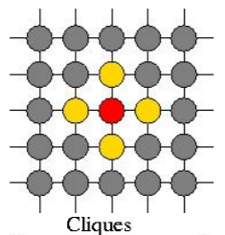
According to Ising Model, each node only has two states. In particular with MRF , xi ∈ {0.255} , and the pair-wise potential function can be written as
where δ is the delta impulse function.
And its corresponding unary potential function can be defined as :
where μx and σx are the mean and standard deviation of the Gaussian distribution of Y for background and foreground respectively

Slide 22
The Segmentation problems can be regarded as an optimization function. We want to find x∗ that maximizes the objective function
where β is the weight for pairwise potential and N xi is the neighbour of xi.

Slide 23
Energy function
Given this approximation, we can maximize each pixel individually, i.e., finding xi by maximizing p(x_{i}|y, x_{Nxi}),where

Slide 24


Comparison for different values of β
β =0.1 β=10
From the images, we can see that if the weight is small, there are some details on the body of the airplane that are treated as the background. The method to fix this is to enlarge the weight to make it emphasis more on the pairwise potential functions.
However, if we apply a very large weight, every pixel in the image tends to have the same value, which disagrees with the purpose of image segmentation

Slide 25
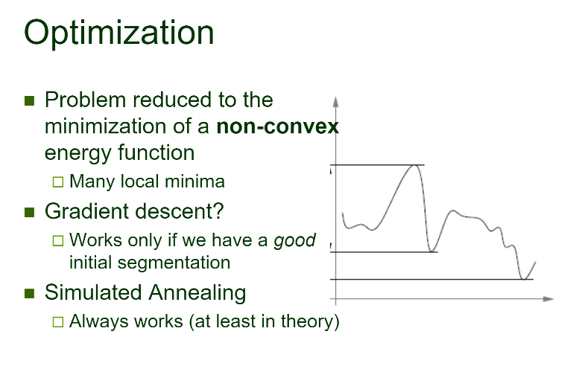

Slide 26
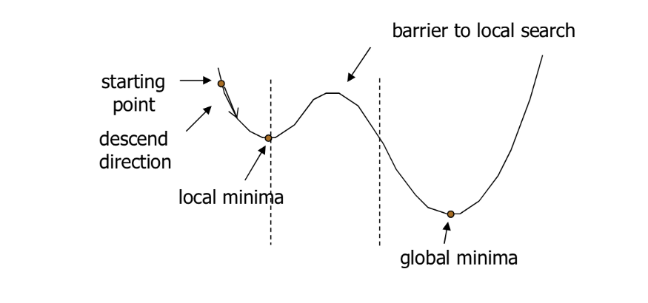

Simulated Annealing
The Simulated Annealing algorithm is based upon Physical Annealing in real life. Physical Annealing is the process of heating up a material until it reaches an annealing temperature and then it will be cooled down slowly in order to change the material to a desired structure.
Simulated Annealing (SA) mimics the Physical Annealing process but is used for optimizing parameters in a model. This process is very useful for situations where there are a lot of local minima such that algorithms like Gradient Descent would be stuck at.
In problems like the one above, if Gradient Descent started at the starting point indicated, it would be stuck at the local minima and not be able to reach the global minima
https://towardsdatascience.com/optimization-techniques-simulated-annealing-d6a4785a1de7

Slide 27
MRF for Image Denoising

